Slide 1
C# Web Profession
C# Fundamentals Module
C# Advanced Course
Fully supported by Microsoft
~500 Offers @ Jobs.BG
Scope
Trainers
Evaluation

Slide 2
C# Web Profession
C# Fundamentals Module
C# Advanced Course
Algorithmic and Conceptual Courses
Prelude to Database and Web Technology Courses
Scope
Trainers
Evaluation

Slide 3
C# Web Profession
Standard .NET API
C# Fundamentals Module
Algorithmic thinking
C# Advanced Course
Scope
Trainers
Evaluation

Slide 4


C# Advanced Course
Scope
Trainers
Evaluation

Slide 5
Trainers
Ventsislav Ivanov
Technical Trainer @ Software University
Certified QA
Knowedge at web testing
Experience as QA automation engineer

Slide 6
Trainers
Valentin Dimitrov
Technical trainer @ Software University
Top performing student from the Software University
Over two years experience in software developing

Slide 7
Trainers
C# Advanced Course
Scope
Evaluation

Slide 8
Examination
Activities
Bonuses
Forum Activity
Nested Linear Structures
Attendance
Algorithmic Problem
C# Advanced Course
80%
25%
10%
Nested Data Structures
Team Work
15%
String Processing
5%
Scope
Trainers
Evaluation
Exercises
Labs

Slide 9
C# Web Profession
C# Fundamentals Module
C# Advanced Course
Scope
Trainers
Evaluation

Slide 10


Your RFID Chip
Students can either
Take RFID chip from SoftUni
Or use their own chip / card
Register your chip number in your SoftUni profile: https://softuni.bg/users/profile/show
Check-in at the reception every time when you come
See your last visits in your profile: https://softuni.bg/users/profile/show

Slide 11









Resources
What We Need Additionally?

Slide 12

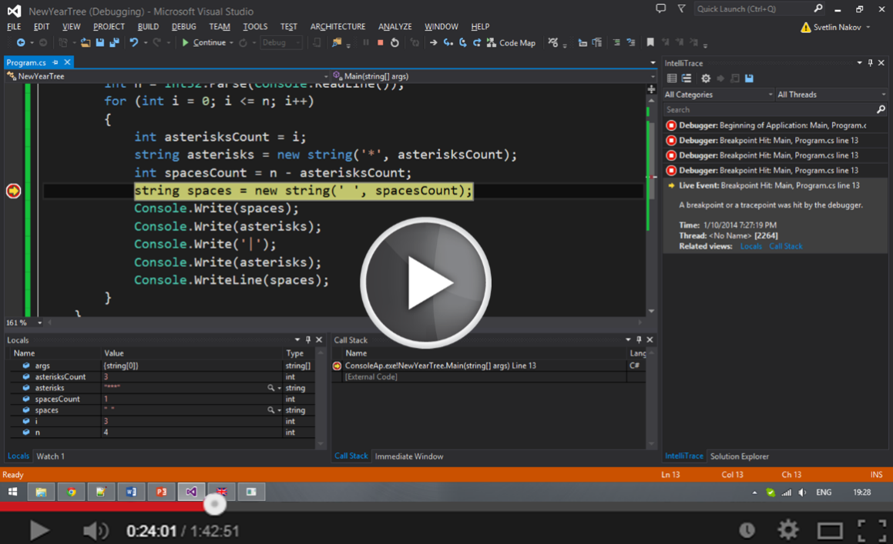

The C# Advanced Slides and Videos
All lecture slides, videos, exercises, projects and other resources are open content, available for free
Visit the course web site to access the course resources

Slide 13

The Free C# Fundamentals Textbook
The official textbook for the course
"Fundamentals of Computer Programming with C#", by Svetlin Nakov & Co., 2013, ISBN 9789544007737
English and Bulgarian versions (as PDF, ePub, …)
Freely downloadable from: www.introprogramming.info
The C# Programming courses @ SoftUni.bg partially follows the book

